Slide 1

MEDIATION

Slide 2

OR
HOW NOT TO GET SUED

Slide 3

Presented by:
David W. Hiers
Trial Attorney
Mediator

Slide 4

If only every employee was the same...

Slide 5


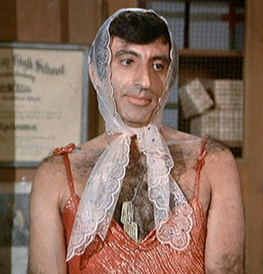







But employees are diverse...

Slide 6
Laws are complicated.
Retaliation
Hostile Work Environment
Whistle Blower
Wage and Hour
FMLA
ADA
TITLE VII
Gender Discrimination
Sexual or Gender Stereotyping
Libel & Slander
Age Discrimination
Assault
Racial Discrimination

Slide 7

Feathers are going to get ruffled.

Slide 8
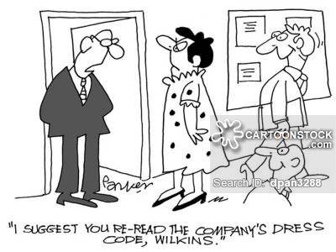

Slide 9

How can you resolve the problems?

Slide 10
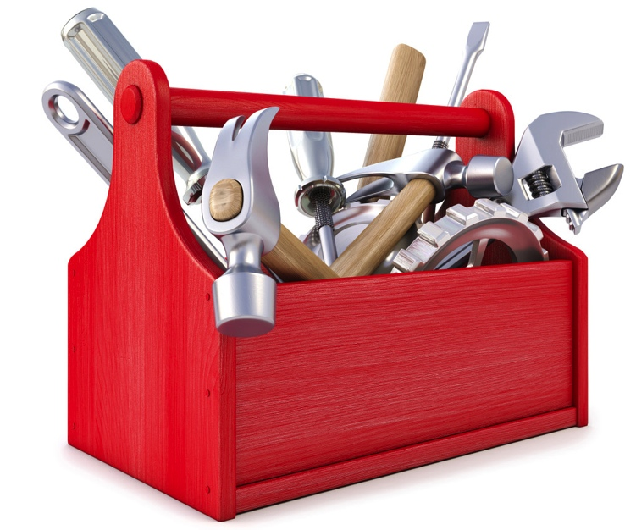
Counseling
Verbal Warning
Written Warning
Progressive Discipline
Transfer
Demotion
Termination
Add Mediation to your tool box.

Slide 11

MEDIATION WORKS!
Labor Commission Recommends it.
ALL State Court and Federal Judges Require it.
80% - 90% Success Rate.

Slide 12
Involves all parties in the process.
Solution not forced upon the parties.
More likely to result in long term solution.

Slide 13
Most problems can be resolved by effective communication.
Understanding BOTH side's position.
Having the true facts of what happened and why.

Slide 14

Why do you need to know this?
1) Most court ordered mediations have an H.R. representative in attendance.
2) You can conduct a pre-suit mediation to avoid litigation.

Slide 15
What types of issues can you mediate?
Retaliation
Hostile Work Environment
Whistle Blower
Wage and Hour
FMLA
ADA
TITLE VII
Gender Discrimination
Sexual or Gender Stereotyping
Libel & Slander
Age Discrimination
Assault
Racial Discrimination

Slide 16
Local Rule 16.3, U.S. District Court –
Northern District of Florida
(A) Definition. Mediation is an opportunity for the parties to negotiate their own settlement. Mediation is a supervised settlement conference presided over by a neutral mediator to promote conciliation, compromise and the ultimate settlement of a civil action… The mediator’s role in the settlement of cases is to assist the parties in the identification of interests, suggest alternatives, analyze issues, question perceptions, conduct private caucuses, stimulate negotiations between opposing sides, and keep order. The mediation process does not allow for testimony of witnesses. The mediator does not review or rule upon questions of fact or law, or render any final decision in the case…
Amended effective October 1, 1999.

Slide 17

supervised settlement conference
Mediation is…
by neutral mediator
Parties negotiate their own settlement

Slide 18

MEDIATOR
identifies interests
  suggests alternatives
  analyzes issues
  questions perceptions
  conducts private caucuses
  stimulates negotiations
  keeps order

Slide 19

No testimony of witnesses
Mediator does not rule upon questions of fact or law
Mediator does not render any final decision in the case

Slide 20
HOW IS A “TYPICAL” MEDIATION CONDUCTED?
JOINT SESSION – Each side has opportunity to present their side of the case. On occasion one side may ask questions of the other, but the other side is not required to answer during the session.
PRIVATE CAUCUS – After the joint session, the parties are separated into “neutral corners.” The mediator conducts the rest of the mediation by conducting private negotiations in each room and relaying the information back and forth. The mediator can reconvene a joint session if he or she believes it will be beneficial.
DRAFT SETTLEMENT AGREEMENT – When a final agreement is reached, it is drafted into a settlement agreement, which is signed by all parties.

Slide 21

Rules

Slide 22

When to Mediate
5 questions to determine when to mediate.
1. Can mediation provide me information I can’t obtain elsewhere?
2. Is this an issue that can be resolved by full communication between all the parties?
3. Does the employer have the ability to make concessions or changes that could resolve the issue?
4. Is the employee likely to change his position with further understanding of the facts?
5. Is the issue more likely to be resolved if the parties mediate a resolution rather than a “resolution” being dictated to the parties?

Slide 23


Slide 24

Parties
(Who needs to attend?)

Slide 25


Slide 26

SETTING THE STAGE FOR A SUCCESSFUL MEDIATION

Slide 27
Questions to ask when
setting up mediation.

Slide 28
How much time will you need?
Where should you mediate?
Who are the decision makers?
How will they attend (live or by phone/video)?
Do they have enough information?
Do they have enough authority?
Should you negotiate before the mediation?
What type of mediator do you need?
Who will present your side at the mediation?

Slide 29

Prepare your side.
Explain the mediation process to the participants so they know what to expect and can prepare.
Explain ALL the facts and law to your side. The Good, Bad & Ugly. (You don’t want them to hear it for the first time from the other side or the mediator!)
Discuss your side's expectations before the mediation. But be realistic. You need to retain flexibility at mediation.

Slide 30
Prepare the other side.
Make sure they understand the process so they can adequately prepare.
What information/evidence do they have that you need to properly analyze the case? Make sure they bring it.
Documents are more effective than mere speech.

Slide 31
Prepare the mediator.
Any special issues that you need to tell the mediator?
(emotional issues; time constraints; client control/expectations issues)

Slide 32
Six key points for a mediation summary:
Who you represent (particularly important in multi-party mediations).
Who will be attending the mediation (and what role they have if not otherwise obvious).
A brief summary of the underlying facts.
The key issues.
The strengths and weaknesses of the case (risk factors).
The settlement negotiations to date.

Slide 33

Warn the mediator about any safety issues.
“My client is armed and dangerous!”

Slide 34

Opening
What tone do you want to set during opening?

Slide 35
Need to present your position without unduly antagonizing the other side.
If the other side gets too mad, they may decide to try the case "just to show you."
The foundation for your settlement is set in the opening.
LISTEN to the other side's opening.
(These are their perceived strengths and the points that you will have to rebut in mediation or trial.)

Slide 36
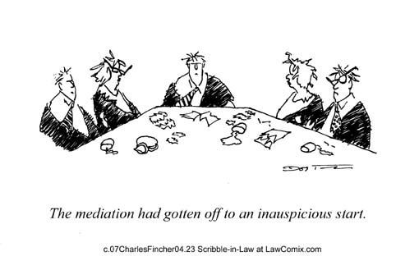

Slide 37
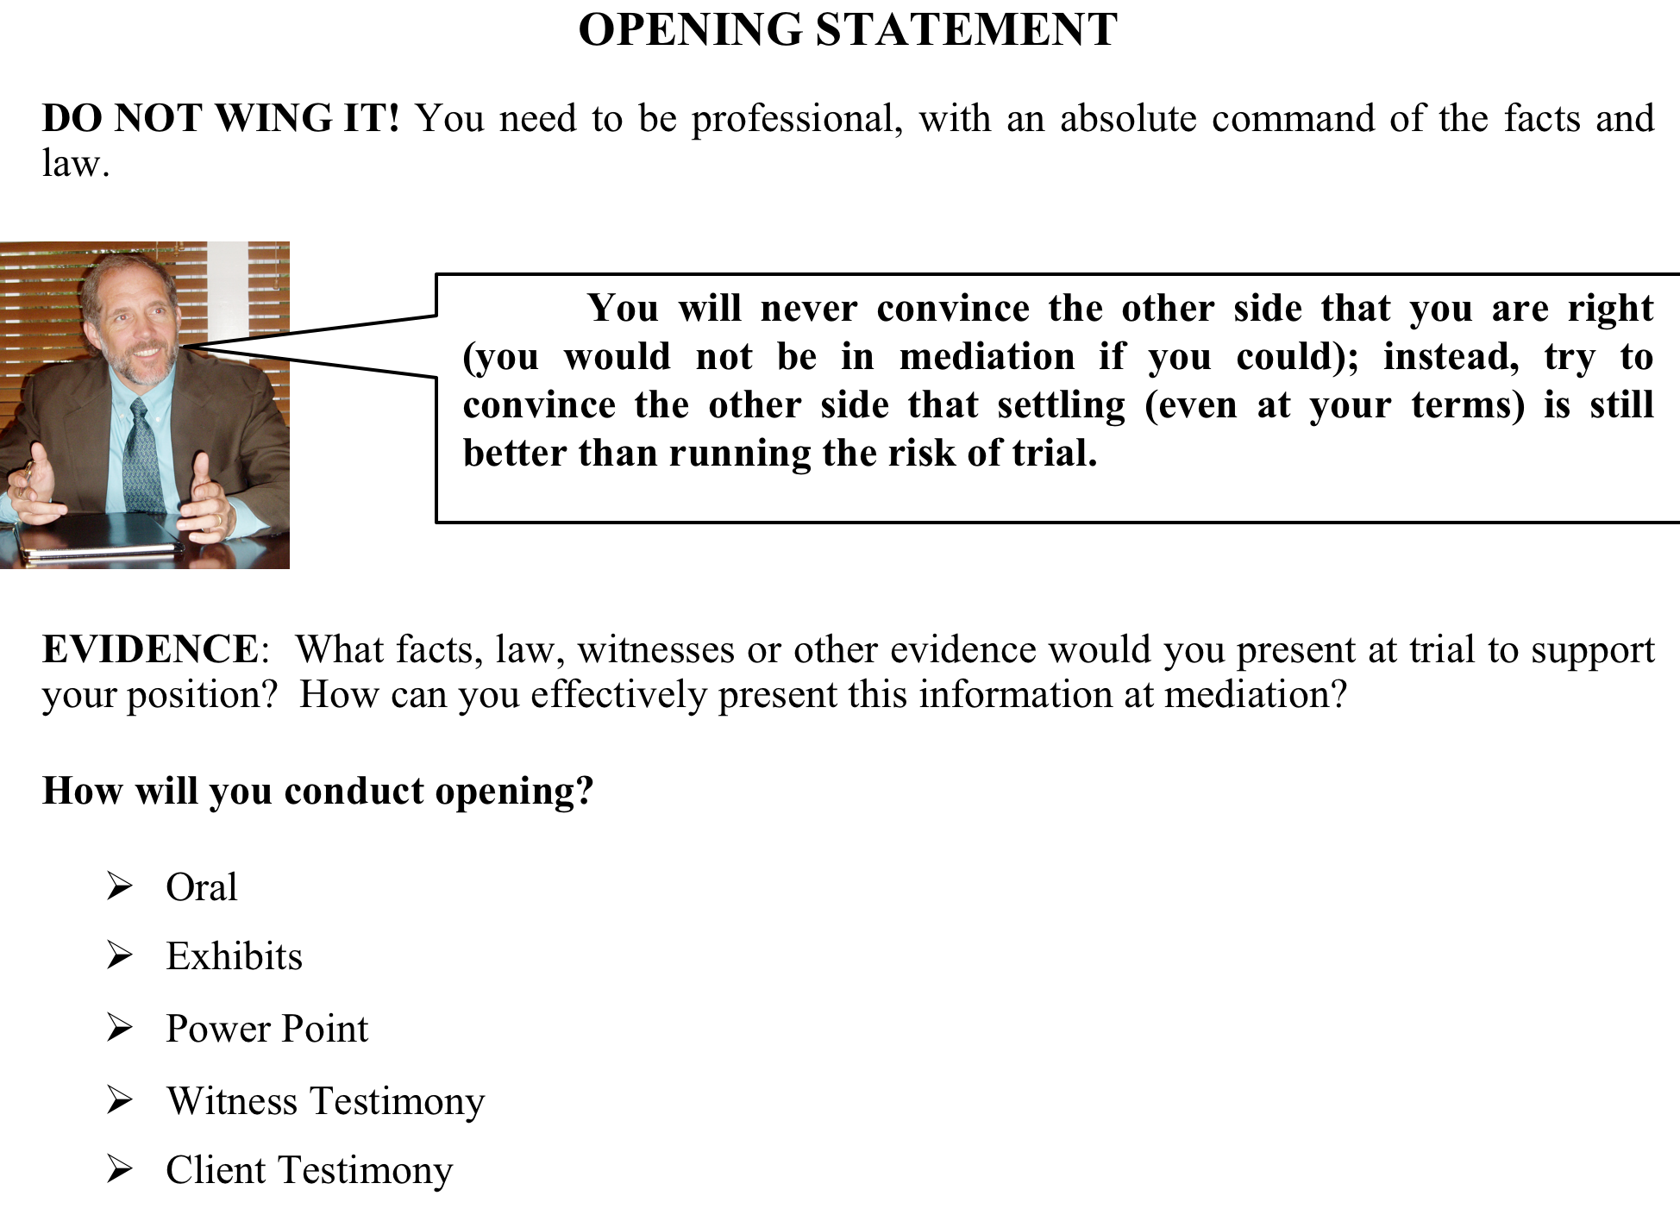

Slide 38

Private Caucus

Slide 39
Understand the mediator’s
abilities and limitations.

Slide 40
Mediator will LISTEN
(Allows both sides to vent)
(I.D. important points/concerns)
Mediator will ADVOCATE
(Explain your position to other side)
(Explain other side’s position to you)
Mediator will help RESOLVE
(Help find common ground)

Slide 41
Mediator can NOT give personal evaluation (on facts or law).
Mediator can NOT force party to settle.
But mediator CAN give client reasons they should settle.
Mediator CAN help fashion settlement.

Slide 42
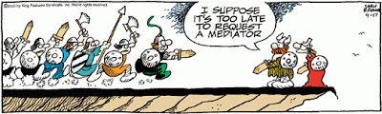
Use the mediator to your advantage.
Use the mediator to your advantage.

Slide 43
If you have any questions/concerns about the mediation, ask the mediator. The mediator can even start working before the opening session and has probably come across your particular problem before.
ASK FOR ADVICE!

Slide 44
Do’s & Don’ts for Negotiating
Do have the mediator advocate your position with the other side.
Do listen to mediator’s critique of your case.
Don’t take unrealistic positions.
Don’t get frustrated by small moves.
(The only important move is the last one.)
Don’t get impatient. Mediation takes time.

Slide 45
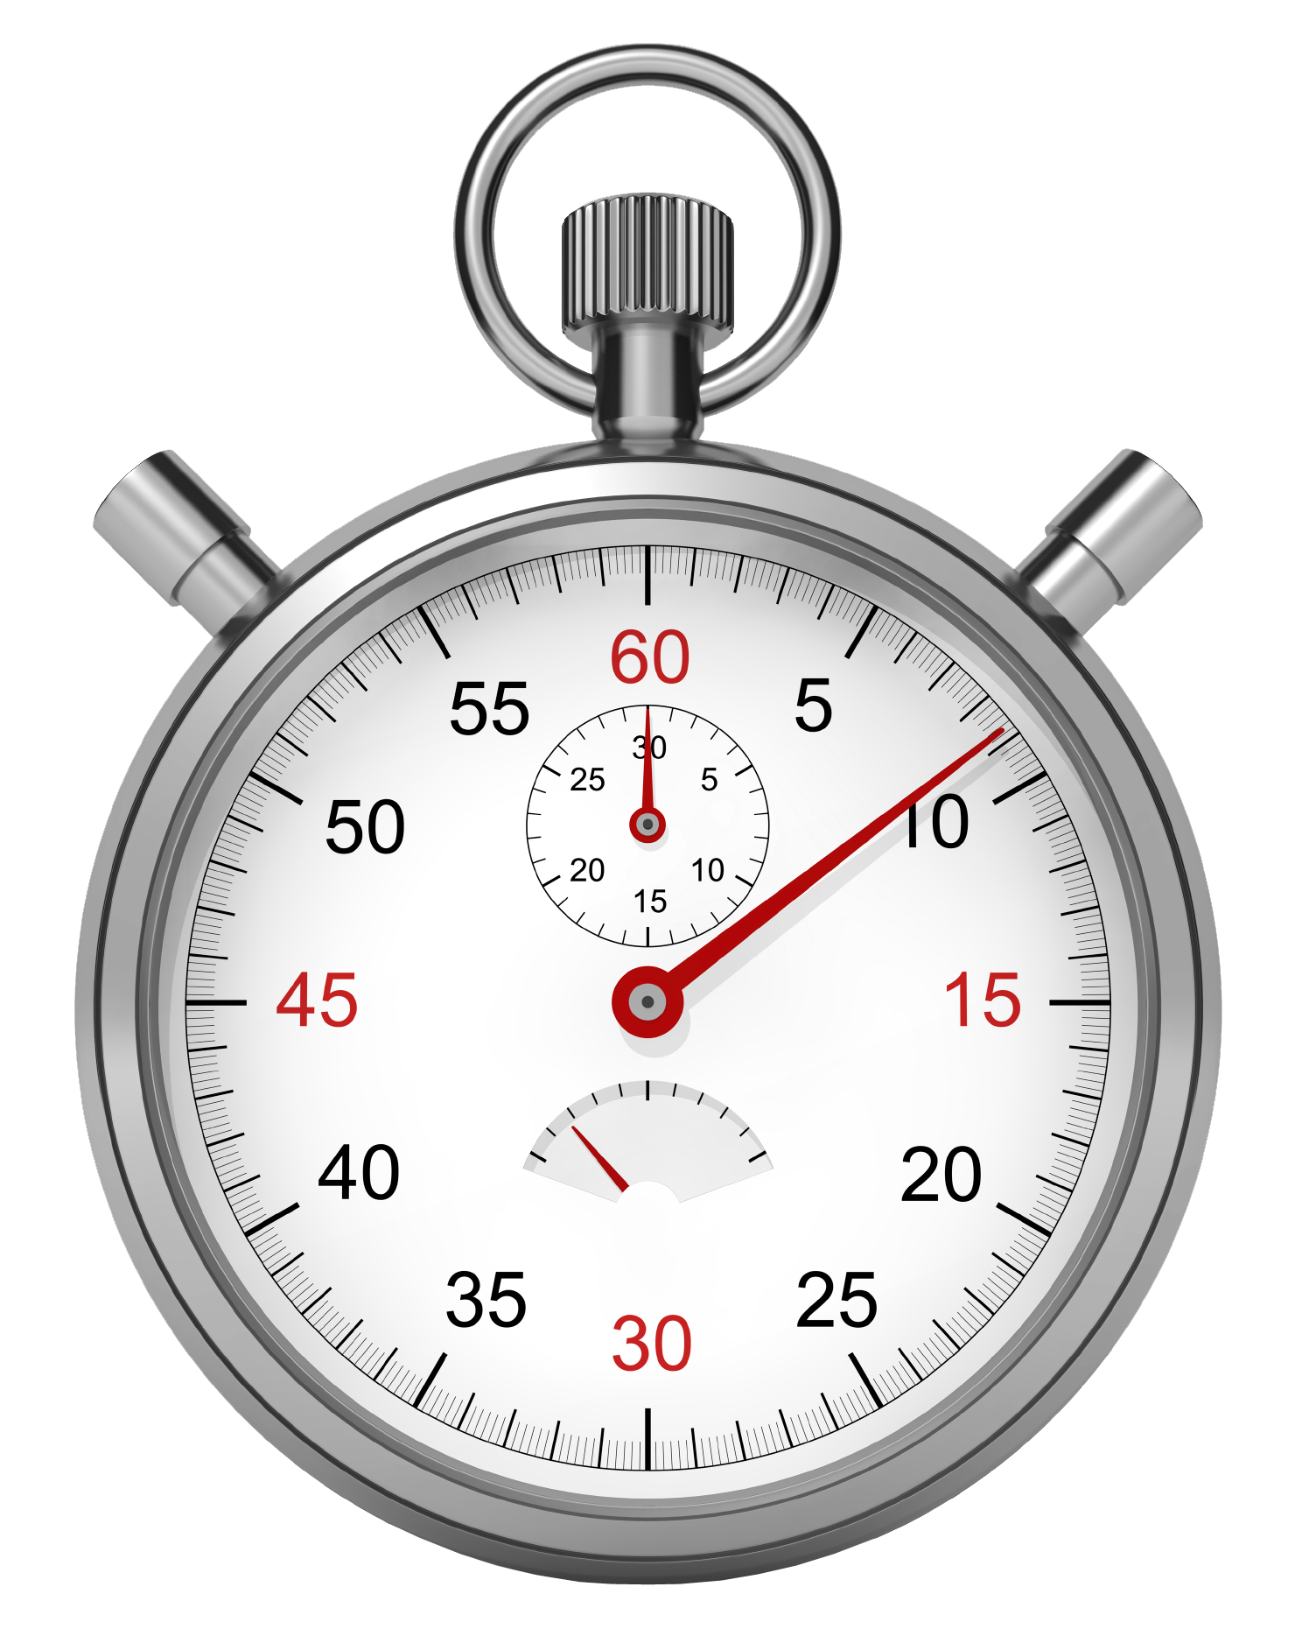
Time-Frame
Analyze your case before scheduling mediation. There is nothing more frustrating than making progress during a mediation only to run out of time because a party (or the mediator) must leave due to other commitments or an early flight.

Slide 46

If your case involves facts that could also be criminal, be very careful not to use words such as “and I won’t go to the State Attorney with this…” as part of your negotiations.

Slide 47
SETTLEMENT AGREEMENT
Must be in Writing
Signed by all parties

Slide 48
Don’t get lazy at the end of the mediation. Carefully write/review the mediation settlement agreement AND GET IT SIGNED BY ALL PARTIES.
This is the document that you worked for all day!
Don’t get sloppy at the end of the mediation.
Carefully write/review the mediation settlement agreement
AND GET IT SIGNED BY ALL PARTIES.
This is the document that you worked for all day!

Slide 49
Your job is to resolve issues so your company can continue production without distraction from malcontent employees or the expense and disruption of litigation.
Mediation is a powerful and versatile tool that when properly done can resolve most issues before they go to trial.

Slide 50
For More Information
Just ask!
(850) 287-0035
HIERS@DAVIDSONHIERSLAW.COM

