Slide 1
Jeri Dembrak
March 8th, 2020

Slide 2
TODAY’S LEARNING OBJECTIVES
TO UNDERSTAND “WELLBEING WORKS FLORIDA” AND OUR
MISSION OF MAKING FLORIDA A HEALTHY PLACE TO LIVE & WORK.
To Serve You, our members by providing resources to you so that you may partner with the leadership in your organization to understand the impact of worksite wellness as part of your organization’s leadership strategy to attract, engage & empower your employees with the tools and resources to be more productive as individuals and members of your organization.
To help you learn as a leader in your organization, how to reduce organizational risk factors such as turnovers, sick days, stress & productivity as well as health care costs.
To let you know that we are here to serve you and provide resources for you to take back that you can consider implementing in your organization whether you are a team of one or many, you can contribute to minimizing risk and increasing employee engagement in your organization!
Notes:
To Serve You – our goal is to provide the tools and resources for our Florida chapters to help make Florida a healthy place to work!

Slide 3
OUR MISSION
Wellbeing Works Florida is Wellbeing Works Florida (WWF) was a collaborative partnership between HR Florida State Council and Tobacco Free Florida (TFF) that helps organizations improve employee wellness. This initiative is supported by our Title Partner Sponsor One Digital, as well as Partner Sponsors LifeLock/Norton and Aetna for whom we are grateful – Robert Ostbye, Leigh Mills, Joe Donahue and Rachel Baker.
We have now expanded that mission to build additional partnerships with other organizations in addition to Tobacco Free Florida and have been reaching out to the Florida Department of Health, the American Heart Association and many others. Our mission is to motivate, empower, and recognize companies/organizations for establishing effective worksite wellness programs and fostering a healthy and thriving workforce.
Notes:
A toolkit was created by the previous Wellbeing Works Director and our 10 Wellbeing Ambassadors aligned to each district in Florida were chosen.

Slide 4
WHAT HAVE WE DONE?
Program officially launched at the Palm Beach SHRM conference last May of 2019.
Since then, we have had over 18 presentations throughout the state.
Over 250 organizations have completed the contact cards for engaging with Tobacco Free Florida to reduce the impact of tobacco and reducing the number of smokers in their organizations.
Over 35 organizations have completed the Success Toolkit – we have asked all chapters to please put a link on their websites so that we can increase participation and select the winners at HR Florida – the link will close by April 30th, 2020.
We have further expanded our mission into We Thrive – Wellness Empowering Tools for Health, Rejuvenation, Innovation, Vitality and Engagement!
Notes:
As a pilot program, we are being agile and pivoting to changes that occur within our structure and within our goals!
A toolkit was created by the previous Wellbeing Works Director and was posted for everyone to participate in – we have closed the toolkit survey as of April 30th and will be sending out the results shortly!

Slide 5
WHAT HAVE WE DONE?
WELCOA Benchmark Presentations were done by WWF & TFF Ambassadors at the following chapters in 2019
Greater Pensacola SHRM St. Lucie County SHRM
Lake Sumter SHRM HR Tampa
SHRM Emerald Coast Big Bend SHRM
Sarasota SHRM Treasure Coast SHRM
SHRM Jacksonville Suncoast SHRM
Mid-Florida SHRM Spacecoast SHRM
Charlotte County SHRM Greater Orlando SHRM
Collier County SHRM Volusia/Flagler SHRM
SHRM Southwest FL South Brevard SHRM
Palm Beach SHRM Treasure Coast SHRM
Greater Miami SHRM
Notes:
Mini presentations on the Welcoa Benchmarks and the resources that TFF provides to employers at no cost were presented in addition to the WWF Toolkit link that was distributed for employers to participate in reducing the number of smokers in their organizations. Again, that has been closed and results are forthcoming!

Slide 6
Why are we continuing to partner with Tobacco Free Florida?
In 2019, Florida represents almost 10% of new cancer cases every year --- the 2nd highest state in the country after California – 131,470 compared with the total number of new cases in the US of 1,762,450.
In 2019, Florida also rates 2nd in the number of cancer related deaths, 45,000 compared to the total number of US cancer-related deaths of 606,880.
From 2016 -2018 for the top five counties of Palm Beach, Hillsborough, Broward, Orange and Miami, the death rate for tobacco-related cancers was 163.8 per 100,000 individuals.
Notes:
These statistics were gathered from the January 2020 issue of Florida Trend Magazine. P.10. We started with tobacco because it has the greatest impact.

Slide 7
SANTA ROSA
OKALOOSA
HOLMES
JACKSON
ESCAMBIA
WALTON
NASSAU
WASHINGTON
GADSDEN
JEFFERSON
HAMILTON
BAY
CALHOUN
LEON
MADISON
DUVAL
LIBERTY
SUWANNEE
COLUMBIA
BAKER
WAKULLA
TAYLOR
UNION
GULF
FRANKLIN
LAFAYETTE
BRADFORD
CLAY
ST JOHNS
DIXIE
GILCHRIST
ALACHUA
PUTNAM
FLAGLER
LEVY
MARION
Tobacco Free Florida
VOLUSIA
CITRUS
LAKE
SUMTER
SEMINOLE
BREVARD
HERNANDO
ORANGE
Media/Marketing
Cessation
State and Community Interventions
67 county programs
PASCO
OSCEOLA
PINELLAS
HILLSBOROUGH
POLK
INDIAN RIVER
MANATEE
HARDEE
OKEECHOBEE
ST LUCIE
DESOTO
HIGHLANDS
SARASOTA
MARTIN
CHARLOTTE
GLADES
LEE
HENDRY
PALM BEACH
COLLIER
BROWARD
MONROE
DADE
Notes:
Tobacco Free Florida (TFF) is a Bureau of the Florida Department of Health.
(Optional) Mission: To protect the people of Florida from the harmful effects of tobacco use.
(Optional) Vision: A tobacco free Florida. TFF program has multiple components including the TFF media campaign, cessation program that provide free counseling and nicotine replacement therapies to all Floridians, and community-based programs with dedicated staff who work to reduce the use and effects of tobacco in every county throughout the state.
TFF’s community-based programs have been supporting local worksites with tobacco prevention and cessation initiatives for over 7 years, assisting with the implementation of more than 400 tobacco free policies at Florida workplaces. As local experts in tobacco prevention, TFF staff can provide free technical assistance to employers seeking to support employees who want to quit.
.

Slide 8
At the local level
SANTA ROSA
OKALOOSA
HOLMES
JACKSON
ESCAMBIA
WALTON
NASSAU
WASHINGTON
GADSDEN
JEFFERSON
HAMILTON
BAY
CALHOUN
LEON
MADISON
DUVAL
LIBERTY
SUWANNEE
COLUMBIA
BAKER
WAKULLA
TAYLOR
UNION
GULF
FRANKLIN
LAFAYETTE
BRADFORD
CLAY
ST JOHNS
DIXIE
GILCHRIST
ALACHUA
PUTNAM
FLAGLER
LEVY
MARION
VOLUSIA
CITRUS
LAKE
SUMTER
SEMINOLE
BREVARD
Tobacco Free Worksites Initiative
Local TFF programs provide support
HERNANDO
ORANGE
PASCO
OSCEOLA
PINELLAS
HILLSBOROUGH
POLK
INDIAN RIVER
MANATEE
HARDEE
OKEECHOBEE
ST LUCIE
DESOTO
HIGHLANDS
SARASOTA
MARTIN
CHARLOTTE
GLADES
LEE
HENDRY
PALM BEACH
COLLIER
BROWARD
MONROE
DADE
Notes:
Each of our state’s 67 local tobacco prevention programs are responsible for providing free assistance to worksites, enabling them to provide proven-effective cessation services to employees and create supportive working environments for those who want to quit.

Slide 9
Helping is easy
Quitting is hard
Tobacco use is harmful to everyone, even nonsmokers
It’s cost-effective
And it impacts all areas of wellness!
Why Help Employees Quit?
Notes:
Easy: Its as simple as establishing clear policies on where tobacco use is appropriate and connecting employees who are ready to quit with proven-effective cessation treatments.
Quitting is hard: While nearly 7 in 10 (68%) of adult cigarette smokers wanted to quit in 2015 (1), more recent studies have estimated that a current smoker may try to quit 30 times on average before successfully quitting for 1 year or longer (2). Employees who smoke benefit from any support provided at the workplace, needing fewer quit attempts to be successful.
(1) Babb S, Malarcher A, Schauer G, Asman K, Jamal A. Quitting Smoking Among Adults—United States, 2000–2015. Morbidity and Mortality Weekly Report 2017;65(52):1457-64. Available at: https://www.cdc.gov/mmwr/volumes/65/wr/mm6552a1.htm?s_cid=mm6552a1_w%20
(2) Chaiton M, Diemert L, Cohen JE, et al. Estimating the number of quit attempts it takes to quit smoking successfully in a longitudinal cohort of smokers. BMJ Open 2016;6:e011045. doi: 10.1136/bmjopen-2016-011045
Health:
Tobacco use is the leading cause of preventable death and disease in the US, killing 480,000 Americans every single year according to the CDC.
There is no risk-free level of secondhand smoke exposure; even brief exposure can be harmful to health (CDC)
For every person who dies from tobacco use, at least 30 people live with a debilitating smoking-related illness (CDC)
In addition to cancer, smoking also causes heart disease, stroke, lung diseases, diabetes, and chronic obstructive pulmonary disease, including emphysema and chronic bronchitis
Centers for Disease Control and Prevention. Smoking and Tobacco Use: Fact Sheet. Available at:
https://www.cdc.gov/tobacco/data_statistics/fact_sheets/fast_facts/index.htm
Cost-effective… (Next Slide)

Slide 10
Why Help Employees Quit?
Total: $6,112
Notes:
Employees who smoke cost businesses, on average, more than $6,000 per year when compared to non-smoking employees. This cost to Florida businesses comes primarily in the form of increased health care costs and productivity losses. Florida worksites lose an average of $4,056 per smoker every year in lost productivity alone.
Berman M, Crane R, Seiber E, et al. Tobacco Control, Published Online. doi:10.1136/tobaccocontrol-2012-050888 (2013)

Slide 11
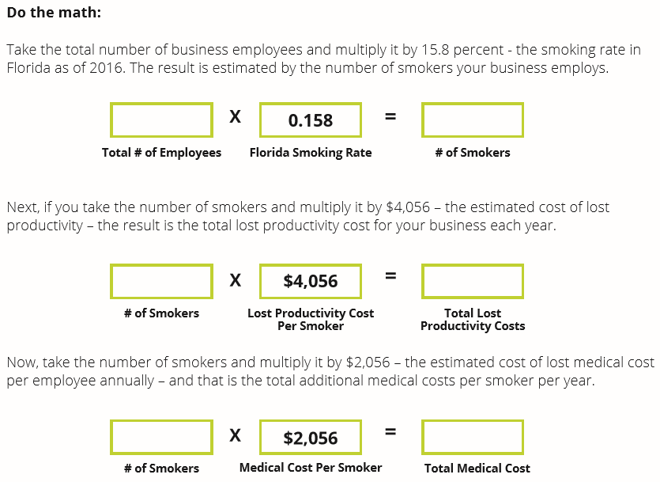
How much does tobacco cost you?
1000
14.5%
145
145
$4,056
$588,120
145
$2,056
$298,120
Notes:
To calculate the potential costs of tobacco use on your bottom line, we are going to use the formula shown to see how much your worksite could be losing in productivity and health related expenses. The results may surprise you!
I’m going to quickly walk you through an example while you calculate your organizations or businesses costs. (worksheets provided to audience members)
Ask for a volunteer to share their calculations and share their thoughts?

Slide 12
Empowering Your Workforce Through a Culture of Total Wellbeing – moving forward and expanding our mission!
Notes:
This is our first presentation to discuss where do you start? How do you being to create a culture of total wellbeing in your organizations?

Slide 13
Why Workplace Wellness?
Notes:
Because when employees are healthy and well, they are more engaged and productive. Workplace wellness reduces healthcare costs but also shows that employers are willing to invest in the wellbeing of their employees have higher retention , productivity and ultimately, profitability.

Slide 14
We’re facing unprecedented levels of poor health
117M -- PHYSICAL
of American adults are categorized as overweight or obese
31% -- INTELLECTUAL & EMOTIONAL
of Americans say their stress has increased in the past year
30% -- INTELLECTUAL , EMOTIONAL & SOCIAL
increase in suicide rates since 1999, making it a national crisis -
Loneliness --- EMOTIONAL & SOCIAL
is a significant health risk, equal to that of smoking and obesity -
Low sense of purpose - SPIRITUAL & PHYSICAL
is tied to increased risk for all-cause mortality and cardiovascular events
Notes:
Top employee wellness programs present health and wellness benefits as an integral part of the whole employment package, in line with healthcare or vacation 3rd bullet - Studies have shown that healthy employees come to work more often and get more done. days.
Source: CCDC Obesgy and overweight, Am Psychological Assoc, Stress in America, CDD US Suicide rates, Cacioppo S et al,ohen, R. et al

Slide 15
Employee Wellness Impacts Healthcare but it also costs organizations in many other ways they may not realize..
Lower productivity
Obesity and other chronic health conditions contribute to significant absenteeism, costing more than 153 billion a year in lost productivity.
Lower engagement
70% of U.S. workers are not engaged at work.
Lower stock performance
Companies that don’t invest in employee well-being are underperforming between 3 – 5% compared to those with robust well-being programs.
Notes:
Top employee wellness programs present health and wellness benefits as an integral part of the whole employment package, in line with healthcare or vacation 3rd bullet - Studies have shown that healthy employees come to work more often and get more done. days.

Slide 16
Why It Matters
Better workplace wellness can carry over to the rest of life and help improve health.
Long-term conditions are closely linked to people’s lifestyle habits. And, changing those habits can lead to prevention of many conditions.
Health issues can affect how people perform on the job and how often they show up for work.
Well-being programs can help organizations save money by reducing health care costs.
Notes:
Top employee wellness programs present health and wellness benefits as an integral part of the whole employment package, in line with healthcare or vacation 3rd bullet - Studies have shown that healthy employees come to work more often and get more done. days.

Slide 17
Making a Case with Data
People are willing to change and try new approaches to getting healthier¹
60%
would like to spend time on mental and physical well-being activities¹
70%
would like to reduce stress in their lives¹
Resources
would help them achieve their health goals¹
43%
said apps would help them progress toward and make regular health goals¹
¹Aetna’s inaugural Health Ambitions Study was conducted in December 2017 and included two distinct surveys fielded by Market Measurement, a custom market research firm. The consumer survey comprised 1,000 responses from consumers 18 and older.
Notes:
Sitting, staring at screens, speeding through life and lack of sleep seem to be a way of life for most Americans. In fact, nearly one-third of Americans say their stress has increased over the past year. Rather than simplifying life, digital tethers seem to contribute to a rise in tension and anxiety. Lack of physical activity and unhealthy eating habits have led to rising rates of obesity and chronic conditions, like diabetes, across the country.
As a result of these distractions, a large percentage of workers are not engaged.
We surveyed our own members and found that 60 percent would like to spend time on well-being, with most focused on eating better and fitness. A significant number said apps would be helpful.
All of this leads most employers to want to improve the wellness experience. Employee engagement in health and wellbeing initiatives is a persistent challenge and a top opportunity but employer commitment to wellbeing has never been stronger. Employers are placing a growing emphasis on understanding employees wants and needs, and refine program designs and activities around a consumer-centric approach.

Slide 18
Redirecting the Investment from Sick Care to Wellbeing¹
Where we spend health care dollars
What actually makes
members healthy
Focusing on the stages of behavior change in everything we do
30%
88%
Genetics
Awareness
Healthcare
40%
_{4%}
Individual behavior
Skill building
Healthy behaviors
20%
_{8%}
Social and environmental
Maintain
10%
Other
Healthcare
¹Artiga S, Hinton E. Beyond Health Care: The Role of Social Determinants in Promoting Health and Health Equity. Henry J Kaiser Family Foundation Issue Brief. May 2018. Available at https://www.kff.org/disparities-policy/issue-brief/beyond-health-care-the-role-of-social-determinants-in-promoting-health-and-health-equity/ Accessed March 14, 2019.

Slide 19
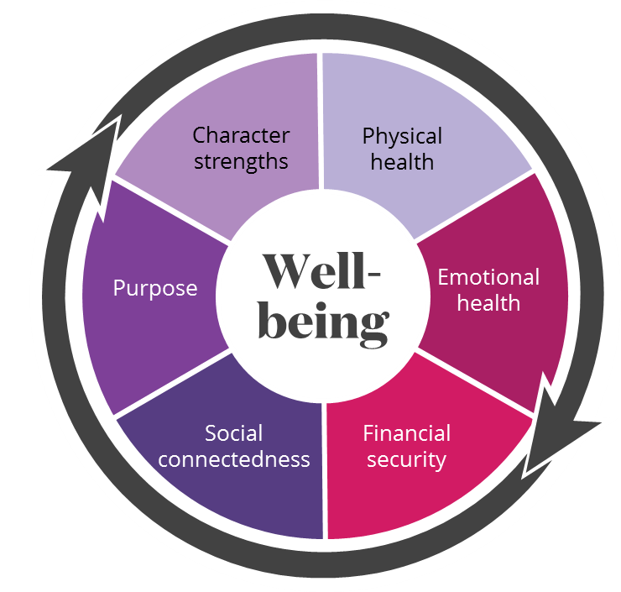
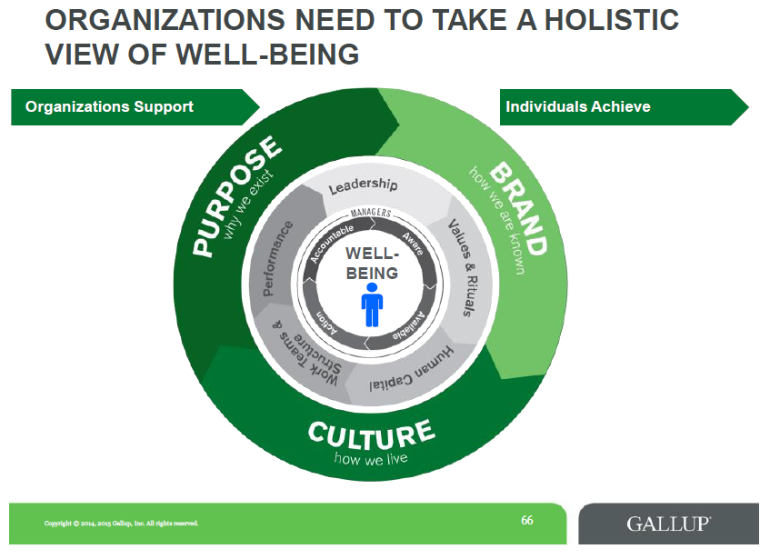
The Next Evolution is Total Wellbeing
Reaching far beyond the conventional notion of healthy as being ‘not physically sick’
Personalized path that creates a culture of well-being
Holistic view of each individual
Building a future vision
A personalized, holistic path creates a culture of wellness
Notes:
Physical wellness was the main focus for many decades in the workplace wellness industry. But we are starting to realize that is just part of the picture. We need to take a holistic/whole person approach now.
According to Gallup, while 66% of people report doing well in at least one of the five main areas, only seven percent of people are strong across all five. What’s more, employees who are thriving in all five areas are more likely to be adaptable, 41% less likely to miss work because of poor health and 81% less likely to seek out a new employer in the next year.
If done well, a focus on holistic well-being has the potential to offset the ill effects of the environment and culture we live in. This is the basis for our total approach to well-being at Aetna.
The most important thing to realize in this new conversation about wellbeing is that all these elements are connected and impact each other
This takes a focus on total well-being
Own your health
Whole person
Have interconnected dimensions
Community support through culture (at work and community)
Know where your employees are struggling
Change the conversation!
Redefine health
Create an ecosystem where all dimensions is integrated
Also, embracing the broad definition of wellness (not just physical activity) has led to a tremendous impact on organizational health and worker productivity and happiness."

Slide 20
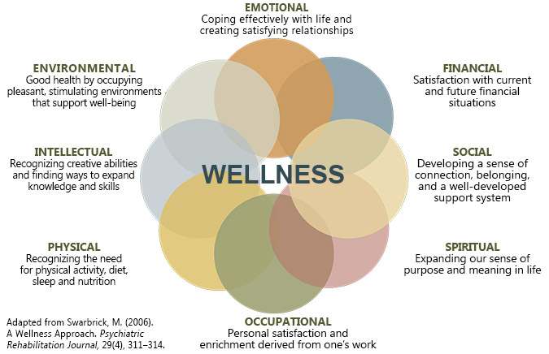
EXPAND YOUR DEFINITION OF WELLNESS – THINK ABOUT ALL OF THESE AREAS
SOMETIMES IT ‘S JUST TAKING FIVE MINUTES TO BREATHE!
We will be sending you info on all these as we begin our learning journey together as we expand this program!
Notes:
THERE ARE EIGHT DIMENSIONS OF WELLNESS – PHYSICAL, MENTAL, This This model is taken from the Substance Abuse and Mental Health Services Administration – under the US Dept. of Health & Human Services. OUR GOAL IS TO PROVIDE RESOURCES FOR ALL OF THESE!

Slide 21
How Do You Start?

Slide 22
Best Practice Standards of Success
Committed and Aligned Leadership
Collaboration in Support of Wellness
Collecting Meaningful Data to Evolve a Wellness strategy
Crafting an Operating Plan
Choosing Initiatives that Support the Whole Employee
Cultivate Supportive Health and Promoting Environments Policies and Practices
Conduct Evaluation, Communicate, Celebrate
Notes:
Do your research and find what approach would work best for your organization.
The Wellness Council of America has dedicated its efforts to studying and promoting the efforts of America’s Healthiest Companies and developed the Well Workplace process. At the core of the Well Workplace model, we have identified seven key benchmarks of success. Specifically, these seven benchmarks are inherent in companies that have built results-oriented workplace wellness programs. The structure helps organizations that are dedicated to the health of their employees create a framework that is tailored toward their values, mission, vision and goals for wellness.

Slide 23
Align Supportive Leadership
Leadership Support
Leaders can shoe their support through various
methods including public recognition,
communications and role modeling
Leadership Accountability
Organizations can encourage leaders to be more supportive of employee well-being by holding them accountable.
Leadership Champions
Leaders should oversee the program, cultivate a supportive work environment and dedicate
necessary resources to the efforts.
Notes:
Leadership should be seen and heard, not just signing off on things in the background.

Slide 24
Collaboration – Wellness Committee and Champions
Wellbeing committees use their knowledge, energy and creative solutions to help create a culture of wellbeing.
What Wellness Champions are
Fired up about their own health and helping to improve the health of others
Already encouraging friends and fellow workers to join wellbeing programs
Leading or taking part in wellbeing programs or meetings
Eager to help others reach their health and well-
being goals
What Wellness Champions may do
Be an “ambassador” for wellbeing programs or health events
Be a person to contact about a wellbeing program or service
Put together programs and share their benefits with other employees
24
©2019 Aetna Inc.
Notes:
It’s important to have leadership support but its equally important to have an internal team to help support your wellness goals. This is where a wellness committee ( a team of wellness champions) comes in to play. These employees will help you build a healthier workplace more effectively and efficiently if done right.
Who do you recruit? Anyone with passion and motivation. Do not discriminate against unhealthy employees. Recruit employees who are going through or have been through their own health journey. They are sometimes the best champions!
How often? Monthly at most, Quarterly at the least; Plan out monthly themes and activities to keep the momentum moving forward

Slide 25
Health Promotion Programs and Activities
Provides opportunities for employees to live
healthier lives. The goal is to help people stay
healthy, get healthy or manage a chronic condition.
Types?
Health fairs
Biometric screenings
Flu shots
Health education classes
Team exercise, weight or nutrition challenges
Health coaching
Stress management/mental health
Chronic Condition management programs such
as diabetes or high blood pressure
Tobacco cessation
Make it accessible, flexible and fun!
Notes:
We are looking to provide you with a list of resources that provide these types of services.

Slide 26
Collect Data
Health assessment
Biometric screenings
Preventive visits
Wellness programs and activities
Notes:
Barb
Collect the low hanging fruit first
Then work with your carrier and broker teams to track the data and refine your strategy moving forward.

Slide 27
Craft an Operating Plan
Make sure the plan reflects the organizational vision, values and purpose.
Work with your insurance carrier, wellness consultant, broker & vendor partners to review data and identify programs that integrate with your culture.
Obtain leadership and other stakeholders support
approval.
Conduct needs assessment of the organization using
multiple data points to understand employee,
organization, community assets, strengths, and gaps.
Align it with well-being, engagement and safety
committees.
Communicate your strategy to all employees and
management.
Evaluate the success of the plan.
27
Notes:
Rachael
Capturing an organization’s goals for wellness initiatives will serve as a roadmap to guide efforts and investments in workplace wellness.
Leadership support – includes budget approval and planning (include incentive management plan)
Needs assessment: . This step helps leadership understand the specific needs with respect to a broad well-being strategy. During this process, assess whether you have leadership support, management capacity, allocation of dedicated resources to support implementation, communications plan and goals that are aligned with your organization’s values and mission.
Once your strategy is approved and supported, align it with well-being, engagement and/or safety committees/initiatives. Always remember to communicate your strategy to all employees and management.

Slide 28
Support the Whole Person
Set goals that include moving toward a
healthy and thriving population (physical and
emotional wellness).
Create a culture of care. Rehumanize the workplace.
Invest and support mental health programs
and de-stigmatization.
Provide social connection and purpose opportunities.
Make work life balance a priority.
Build trust and show respect.
People will thrive when we change the very
nature of how we work and connect with them.
Notes:
This goes back to the holistic wellbeing slide with the well-being dimension models. Organizations must reconsider how they approach wellbeing amongst their population.
When employees believe their employer cares about their health and wellbeing, they are 38 percent more likely to be engaged, 10 times less likely to be hostile, 17 percent more likely to still be working there in a year, 28 percent more like to recommend their organization and 18 percent more likely to go the extra mile. In other words, companies that focus on and commit to a culture of wellbeing benefit from a boost in engagement, morale, retention, recruitment and performance.
Welcoa stated that “HUMANIZATION” is one o f their 5 top workplace wellness trends for 2019.
Boosting human performance and happiness is more than having yoga mats and apples at work… it is rehumanizing the workplace, and supporting the triple bottom line – people, planets and profits. When we put people first, profits tend to follow.
This serves to enhance decision-making skills and brings the right intervention to an organization in support of employees across the health continuum.
4. Volunteerism and community events/races

Slide 29
Environments, Policies and Practices
Create a culture of overall wellbeing
Create policies that support wellbeing (i.e.: lit, welcoming stairwells and messaging, healthy vending/cafeterias/catering, standing/treadmill workstations, bike racks, walking paths, etc.)
Offer customized, intrinsically motivating wellbeing programs with incentives.
Full integration of HR and organizational functions with employee wellbeing and work/life quality initiatives
Partner with your IT Team – how do help employees be safe online & in the office?
29
©2019 Aetna Inc.
Notes:
To achieve an effective workplace well-being program, keep in mind that your organizational environment must also support your well-being initiatives. This is where creating a culture around optimal employee well-being comes into play.

Slide 30
Evaluate, Communicate, Celebrate
Have a comprehensive evaluation strategy based on a guiding framework.
Evaluate data collected to determine how successful the approach has been and in what ways it can be improved.
Evaluation data should be rigorous, unbiased and inclusive.
Data should be communicated to ensure continuous improvement efforts in worksite wellness.
Consider your evaluation approach (ROI vs. VOI)
Celebrate organizational efforts and employee success stories!
Notes:
Wellness program stats indicate that tracking results produces the best wellness outcomes.
66% of employers who tracked wellness efforts observed increased productivity — and that 67 percent of employees who took part were more satisfied at work.
ROI/VOI: Workplace Wellness Goes beyond ROI. 75% of employers are offering wellness programs more to improve worker health and well-being, less to curb health care costs. VOI is just as important and becoming more valued data with employers
Video of success story

Slide 31
Communicate, Communicate, Communicate!
Tips
Create awareness and motivation through the year.
Time it right and plan monthly themes.
Use both electronic and print communications.
Develop a brand and logo.
Factors to consider
Frequency of communications
Relevance of incentives
Level of management support
Willingness of your employees to participate
Types
Emails
Flyers/Posters (i.e.: bathroom stall flyers)
Direct mailers
Newsletters
Intranet site or designated page
Onsite events
Wellness Champions
Staff meetings
31
©2019 Aetna Inc.
Notes:
You can have the best wellness program, but that value of the program depends on engaging your employees at the right times, in the right ways, with the right messaging. Aetna’s most strategic customers are ones that provide an incentive and reward program, convey management support for the program and provide a consistent communications strategy throughout the year.
Develop a communications plan/strategy based on your culture and how your organization communicates.
1. It may take several communications before employees become interested or participate. Make them appealing, concise and regular.
2. Choose a time when your employees will be able to focus on the messages you send them. Consider avoiding your busiest times of the year (such as during tax season for accounting firms). Also, avoid times when employees usually take vacations or celebrate holidays.

Slide 32
Let’s Talk Incentives
Questions to ask:
What is your overall goal?
What type of incentive program do you
want?
What is your approach?
What methods will you use to
incentivize?
How much per employee?
What other members of your leadership team can you enlist as an additional advocate to promote wellness in the workplace & find $$$– IT, Finance, Marketing?
Notes:
*WellSteps article “How effective wellness programs do wellness incentive management
Every wellness program should be using incentives. They are an important part in helping employees stay motivated to make long-term behavior change. The nation’s best wellness programs are able to find a balance between the requirements needed to deliver an incentive program and the need to help employees improve their health.

Slide 33
10 Best Practices
Pick the right incentives that are meaningful and motivating.
Survey your employees to see what incentive would work for them.
Decide which behaviors, activities, or health status to incentivize
Assign point values to each reward item.
Determine which items can and cannot be verified
Make it easy for employees to verify
Develop a process that will make it easy to determine who has earned the different incentives
Purchase and distribute incentives correctly
Handle appeals, problems, and unanticipated issues
Produce year-end accounting and participation reports.
Notes:
*WellSteps article “How effective wellness programs do wellness incentive management
Every wellness program should be using incentives. They are an important part in helping employees stay motivated to make long-term behavior change. The nation’s best wellness programs are able to find a balance between the requirements needed to deliver an incentive program and the need to help employees improve their health.

Slide 34
Barriers

Slide 35
Barriers to Successful Wellbeing Programming
Difficulty with finding time to participate – 39%
Dispersed population – 27%
Difficulty maintaining momentum – 26%
Prohibitive costs – 25%
Lack of interest by workers – 24%
New challenge of having employees working
remotely s well as additional stress with having
children/parents at home & being quarantined at home ----larger percentage!
Notes:
*Intl Foundation of Employee Benefit Plans
Barb

Slide 36
HR CAN HELP MANAGERS LEAD REMOTE TEAMS

Slide 37
Help them reset their expectations as to how work gets done --- with children at home, it might be easier to set meetings early in the morning or later in the evening to accommodate.
Notes:
Most teams are socialized and accustomed to synchronous work and standardization. They work together, located in the same office, maybe have breakfast or lunch together, under the same working conditions, with the same work schedule. In a quarantined environment, managers must help their teams shift immediately to asynchronous work and personalization. You’ll need to reset expectations for how work gets done, letting go of when and how tasks are accomplished, allowing team members to accomplish their responsibilities at times that work for them. This means focusing on results and offering more flexibility – Set the top five for the week!

Slide 38
Help them use instant messaging for a daily standup or huddle early in the morning – “I miss seeing you!”
Notes:
Coach them to Overcommunicate & Stay in Touch. Sociometric research proves that shorter communication cycle times are more effective in building and sustaining morale and engagement. Use instant messaging to stay in touch daily during the week. You might want to hold a huddle each day, ideally by video, perhaps rotating who leads it. Set the expectation that everyone be present and not distracted maybe pausing for a mindful moment to focus. Model what it means to show up as a virtual team player. Check in to see how everyone is doing on their top five and see how others can help them complete. – “we’re all in this together!”

Slide 39
Work with leadership and managers to assign buddies & peer coaches for mutual support – “I’m here for you!”
This Photo by Unknown Author is licensed under CC BY-SA-NC
This Photo by Unknown Author is licensed under CC BY-NC
Notes:
HR can help leadership & managers assign buddies and peer coaches across departments to add a layer of mutual support & connectedness. Trying to meet everyone’s needs equally will exhaust the capacity of most managers. To distribute that responsibility, organize team members into pairs with each individual assigned as a buddy and peer coach to their assigned colleague. This shared leadership model creates a second layer of mutual support and guards against emotional isolation. Ask the buddies to check in daily and assess overall engagement and well-being. If people haven’t filled this role before, it can be helpful to give them some guidance.

Slide 40
Learn to interpret tone and voice as proxies for face-to-face feedback. –”Listen intently!”
Notes:
It’s harder to read the emotional cues of your people when you aren’t in the same room. Listen with intention and pay attention not only to what is said but how it is said such as pitch, volume and inflection as well as physical gestures in video communication. Also read emails more carefully paying attention to the tone of written communication and how often it is being sent and to who. If you know your people well, changes in these patterns will help you identify early that a team member may need some additional support. Listen with intention.

Slide 41
Model optimism and drain the team of fear. – “Use emojis!”
Notes:
Optimism is contagious. Leaders who always look for the upside – for example, the upside of this coronavirus experience is that workers are able to show that they can be productive from home even in the face of numerous obstacles. Employees are learning to be more resilient which is a good sign given our new VUCA world. Communicating hopefulness and confidence in the future are better helps their team members find meaning and purpose in work, especially under stressful conditions.

Slide 42
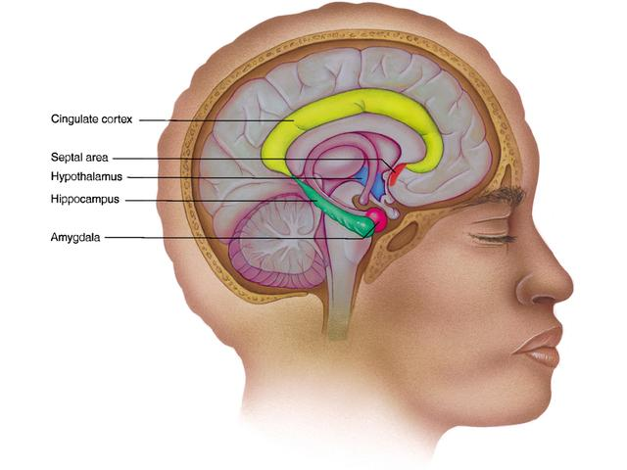
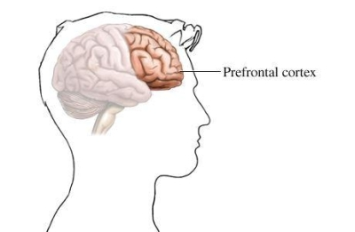
The neuroscience of emotions
Emotional Brain
Satisfied
Meaningful
Valued
Useful
Broaden
Creative
Engage
Thinking Brain
Reward
Decisions
Event
Threat
Behaviour
Concern
Worry
Frustration
Stress
Narrow
Limit
Disengage
The way you feel can enhance or impair your responses, decisions and behaviour!
Notes:
Remember the amygdala, when you perceive a threat, fear freezes initiative, ties up creativity, and yields compliance instead of commitment. Finally, consider that constraints are often the enabling factor that sparks innovation. Again, choose to perceive a reward and not to be afraid and invite your team to use the quarantine conditions as a stimulus for new ideas.

Slide 43
Continually gauge stress and engagement levels.
Photo by Pedro Vargas
Notes:
Make it crystal clear to your team members that your chief concern is their well-being. Take time to monitor their engagement by periodically asking each team member two quick questions. First, on a zero-to-10 scale, rate the level of stress you currently feel. Second, using that same scale, rate your level of overall engagement. Your intuitive or impressionistic sense of the individual may be wrong, so it helps to get quantitative responses.

Slide 44
LEAD BY EXAMPLE
BE CALM
BE CONFIDENT
BE COURAGEOUS
BE RESILIENT
DO COMMUNICATE AUTHENTICALLY & OFTEN – DAILY
DON’T BE PARALYZED BY ANALYSIS
KEEP IT SIMPLE & BRIEF
OKAY TO SAY I DON’T KNOW, WE HAVEN’T DECIDED YET, DON’T KNOW – BE TRUTHFUL
Notes:
Schedule regular talks with your leaders and with your staff --- let them know they really need to practice these skills especially during these times!

Slide 45
Provide resources for continued learning such as LMS, 5 to 10 minute microlearning course covering a specific tool, behavior or skill.
Notes:
Ask managers to reach out to various team members, maybe they would like to share a quick tool they are using with the kids to keep them occupied or a quick recipe or industry-related article they read or a new software they read about. Rotate the delivery of these lessons among team members and allow them to identify their own topics for training. You might ask a different team member to debrief the lesson and lead a short discussion about the application, relevance, and implications of what everyone learned.

Slide 46
Even remotely, Wellbeing Works Florida is agile & looks to help our members adapt to our new VUCA (volatile, uncertain, complex & ambiguous) world!!
We Thrive in Florida
Photo by Martin Adegeest

Slide 47
Wellbeing Works Florida – Organizational Resources We will be posting additional ones on the HRFlorida.org/Wellbeing Works Florida webpage – stay tuned!
WELCOA 7 Benchmarks
Gallup's Culture Transformation framework
Kaiser Permanente
National Business Group on Health
Harvard Business Review
Virgin Pulse -- Accelerating Outcomes for Health Plans The Corporate Wellbeing Market -- Explosive Growth
Virgin Pulse Resources
Notes:
I encourage and invite you to take stock of your own organization and consider what you’re doing to support wellbeing across the holistic well-being spectrum an dhow you align with these best practices. Notice areas of strength and areas of opportunity. Think about how you might redefine “well-being” at your company considering a broader, more comprehensive approach.
Kaiser – 4 steps to workforce health (Assess, Plan, Engage, Measure)

Slide 48
Wellbeing Works Florida – Chapter Resources We will be posting additional ones on the HRFlorida.org/We Thrive In Florida webpage! Chapter Programming Resources - one hour videos already approved by SHRM – please see below we’ve only just begun…
Wellbeing Predictions 2020 Webinar
The Business of Health Employees -- 2019 Survey Results
Build Better Business with a Holistic Wellbeing Approach
Welcoa Resources for Wellbeing

Slide 49
A HUGE THANK YOU TO OUR SPONSORS!
THANK YOU FOR YOUR TIME, WILLINGESS AND SUPPORT IN HELPING TO MAKE FLORIDA A HEALTHY PLACE TO WORK!
Notes:
Please stay tuned for more resources, more ideas and connect with your WTIF Ambassadors and schedule a few minutes before or after a meeting to talk about the Impact of Identity Theft on Wellness or for a quick Mindful Minutes practices -- we are all in this together as we all learn to Thrive in Florida!

Slide 50
Creating a Culture of Wellbeing
This program counts as 1.5 hours of PDC toward SHRM-CP and SHRM-SCP recertification. The program number is 20-HGUSE
This program has been approved for 1.5 hours Business Strategy recertification credit by the HR Certification Institute. The program number 521478
2020 HR Florida State

